Slide 1
IBM University Engagement Project Submission
“Exploring the Power of Agentic AI with IBM Granite and LangFlow”

Slide 2

Project Tile – Smart Home Energy Advisor Agent
Domain of Project – Electrical Engineering
Student Name | Recent Passport Photo | Email ID | Mobile number [WhatsApp]
Nilesh Vadgama |  | Vadgama.vgi@gmail.com | 9XXX0 8XXX3

Slide 3
Problem Statement -
Problem Statement : Smart Home Energy Advisor Agent
The Challenge
Rising electricity demand and energy costs make it difficult for households to understand how their daily habits impact power consumption. Most users only receive monthly bills, which provide limited insight into appliance-level energy usage. As a result, people often waste electricity unknowingly, highlighting the need for an AI-powered system that analyzes usage patterns and provides actionable energy-saving recommendations.
The Objective
Build an AI-powered Smart Home Energy Advisor Agent that analyzes household electricity consumption data and provides intelligent recommendations to optimize energy usage.
1. Energy Consumption Analysis – Analyze household electricity usage patterns from smart meters or appliance usage logs.
2. Personalized Energy Recommendations – Suggest energy-saving actions based on the user's consumption behavior and daily routines.
3. Appliance Usage Insights – Identify appliances that consume the most electricity and recommend optimal usage strategies.
4. Electricity Bill Estimation – Predict monthly electricity bills based on current usage patterns and tariff structures.
5. Energy Efficiency Suggestions – Recommend simple practices such as reducing peak-hour usage, scheduling heavy appliances, or upgrading to energy-efficient devices.

Slide 4
Technology Used
Tech Stack (Mandatory)
Use any one of the following approaches:
LangFlow + IBM watsonx.ai + Granite Models
IBM Cloud Agentic Lab with IBM Granite Models
Replicate with LangChain + RAG + IBM Granite Models
I used LangFlow + IBM watsonx.ai + Granite Models

Slide 5
Proposed Solution -
Proposed Solution: Smart Home Energy Advisor Agent
The proposed solution is a Build an AI-powered Smart Home Energy Advisor Agent that analyzes household electricity consumption data and provides intelligent recommendations to optimize energy usage.
Energy Consumption Analysis – Analyze household electricity usage patterns from smart meters or appliance usage logs.
Personalized Energy Recommendations – Suggest energy-saving actions based on the user's consumption behavior and daily routines.
Appliance Usage Insights – Identify appliances that consume the most electricity and recommend optimal usage strategies.
Electricity Bill Estimation – Predict monthly electricity bills based on current usage patterns and tariff structures.
Energy Efficiency Suggestions – Recommend simple practices such as reducing peak-hour usage, scheduling heavy appliances, or upgrading to energy-efficient devices.

Slide 6
Langflow component Used -
1) Chat Input – Interface where users enter their queries, preferences, or meal details (text/voice/image).
2) IBM watsonx AI Agent - Processes user input using Granite models to generate personalized nutrition insights and recommendations.
3) Name of IBM Granite model - Granite-4.0-8B-Instruct → Fast, efficient for real-time diet recommendations
4) Chat output -Displays AI-generated responses such as recommendations to optimize energy usage, Appliance Usage Insights, Electricity Bill Estimation and Energy Efficiency Suggestions.
5) File component - Stores and retrieves user data, Energy usage logs, Electricity Bill and Energy Consumption for analysis and tracking.

Slide 7
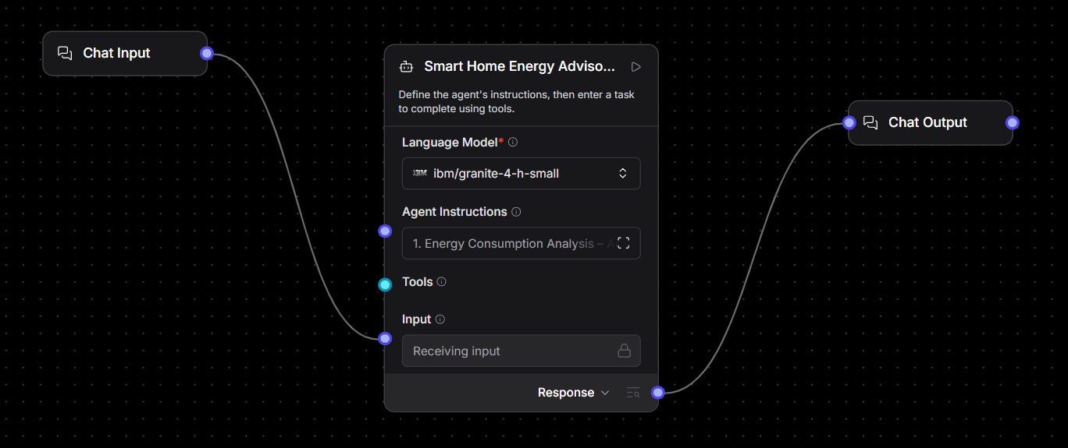
Langflow workflow -

Slide 8
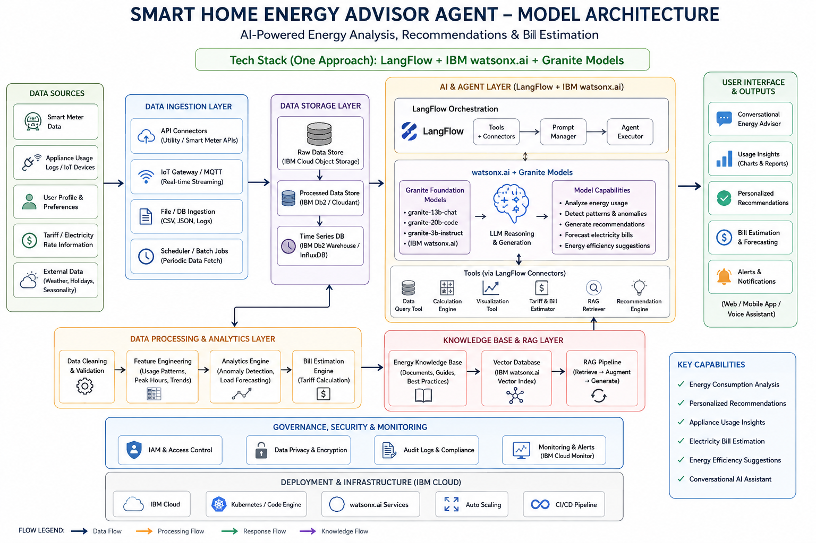
Architecture blueprint

Slide 9

Role of Agentic AI in the solution
Role of Agentic AI in Nutrition Agent
Agentic AI enables the Nutrition Agent to function as an intelligent, autonomous system rather than a simple chatbot. Using IBM watsonx.ai and IBM Granite models, it coordinates multiple specialized agents to deliver personalized nutrition guidance.
Each agent performs a specific role—such as retrieving nutritional data, generating diet plans, providing health advice, and analyzing food logs—while working collaboratively. This multi-agent approach ensures efficient task execution and accurate results.
Agentic AI also brings context awareness, understanding user details like age, health conditions, and fitness goals to generate tailored recommendations. It supports real-time adaptation, continuously updating suggestions based on user inputs like daily meals.
Additionally, agents communicate with each other, enabling better decision-making and improved outcomes.
Overall, Agentic AI makes the system proactive, personalized, and goal-driven, acting like a smart digital nutritionist that helps users maintain a healthy lifestyle.

Slide 10
Technology Used
Langflow platform -For designing and orchestrating multi-agent workflows visually
IBM Grainte model - for eg – ibm-granite-3-2-8b – For natural language understanding, reasoning, and personalization
IBM Cloud – It provides the infrastructure to build, deploy, and scale the Nutrition Agent efficiently. IBM Cloud enables a reliable, secure, and scalable environment for deploying the Nutrition Agent.
RAG– RAG to fetch real data first, then generate intelligent answers, making the Nutrition Agent more trustworthy and effective.
IBM Watsonx.ai - For model deployment, embeddings, and AI governance
Vector Database (FAISS/Chroma) – For RAG-based nutritional data retrieval

Slide 11
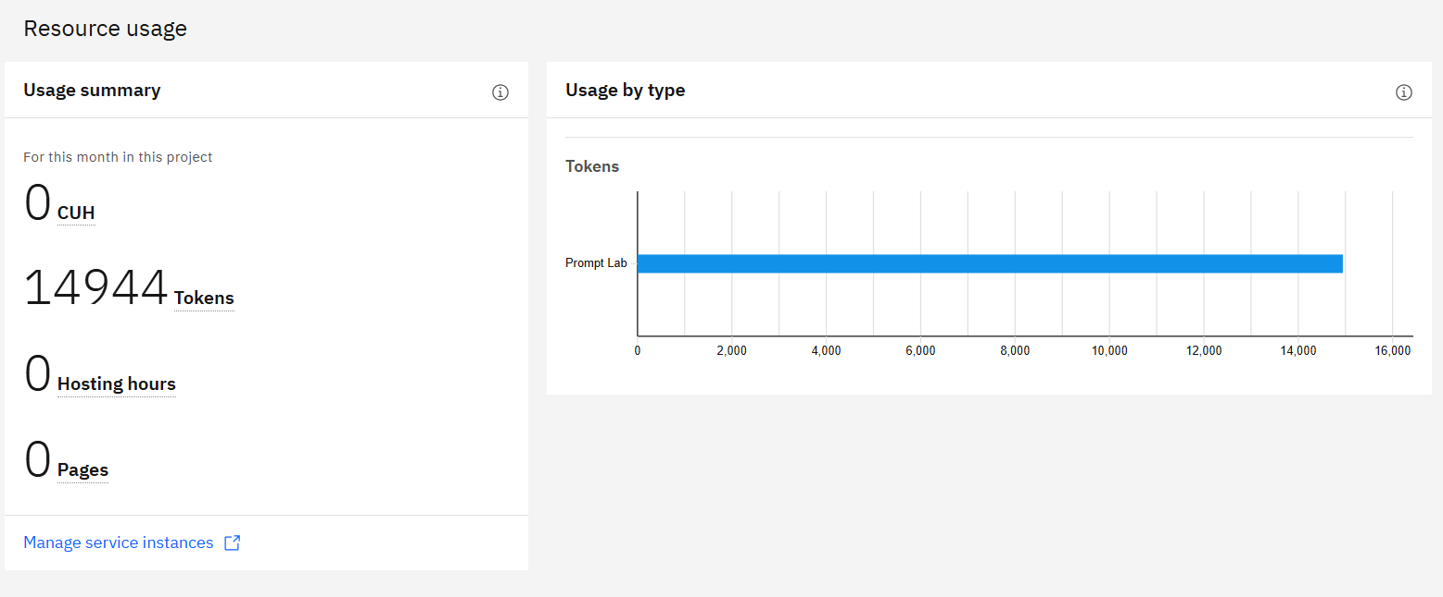
Token Usage
14944 token are used

Slide 12
Novelty and Uniqueness
The proposed Nutrition Agent stands out by combining Agentic AI, RAG, and personalization into a single intelligent system.
Multi-Agent Intelligence – Instead of a single chatbot, multiple specialized agents collaborate to deliver accurate and context-aware nutrition guidance.
RAG-Based Accuracy – Integrates real-time data retrieval with AI generation, reducing misinformation and ensuring trustworthy recommendations.
Hyper-Personalization – Tailors diet plans based on health conditions, cultural preferences, and fitness goals.
Real-Time Feedback Loop – Continuously adapts recommendations based on daily food logs and user behavior.
Multi-Modal Input – Supports text, voice, and image-based meal tracking for better usability.
Preventive Healthcare Focus – Goes beyond diet planning to provide disease-specific nutrition advice.
Scalable & Enterprise-Ready – Built on IBM watsonx.ai with IBM Granite models, ensuring reliability and governance.
This makes the solution a smart, adaptive, and proactive digital nutritionist, not just a static diet recommendation tool.

Slide 13
Git Hub Link
https://github.com/NileshVadgama59/Smart-Home-Energy-Advisor-Agent

Slide 14
Future Scope
1.Integration with Wearables Devices –
The system can be integrated with smartwatches to collect real-time data such as energy consumption, current usage of energy, current load, time patterns of energy consumption, peak demand, normal demand, minimum demand, Voltage and current. This will enable the Agent to provide more accurate and dynamic recommendations based on actual user activity and usage of energy.
2.AI-Powered Voice Assistant & Atomization Support –
Enhancing the system with a voice-enabled assistant and support for multiple languages will improve accessibility. Users can interact naturally in their preferred language, making the solution more inclusive and suitable for diverse populations, especially in regions with varied linguistic backgrounds. also, automatic control on devices that consume more energy or not used by user.
·
·

Slide 15


